Slide 1
Transactions, Recovery and Concurrency (I)

Slide 2
Air-line Reservation
10 available seats vs 15 travel agents.
How do you design a robust and fair reservation system?
Insufficient resources
Fair policy to every body
Robustness

Slide 3
Failures
Number of factors might cause failures in user requirements processing.
System failure:
Disk failure - e.g. head crash, media fault.
System crash - unexpected failure requiring a reboot.
Program error - e.g. a divide by zero.
Exception conditions - e.g. no seats for your reservation.
Concurrency control - e.g. deadlock, expired locks.

Slide 4
To handle failures correctly and efficiently
Each database user must express his requirements as a set of program units.
Each program unit is a transaction that either
accesses the contents of the database, or
changes the state of the database, from one consistent state to another.
Example transaction: buy a ticket from Sydney to N.Y. by JAL.
A transaction must be treated as an atomic unit.
Sydney → Tokyo → LA
→ N.Y
It does not make sense
only partial trip has tickets

Slide 5
Transaction Processing
Three kinds of operations may be used in a transaction:
Read.
Write.
Computation.

Slide 6
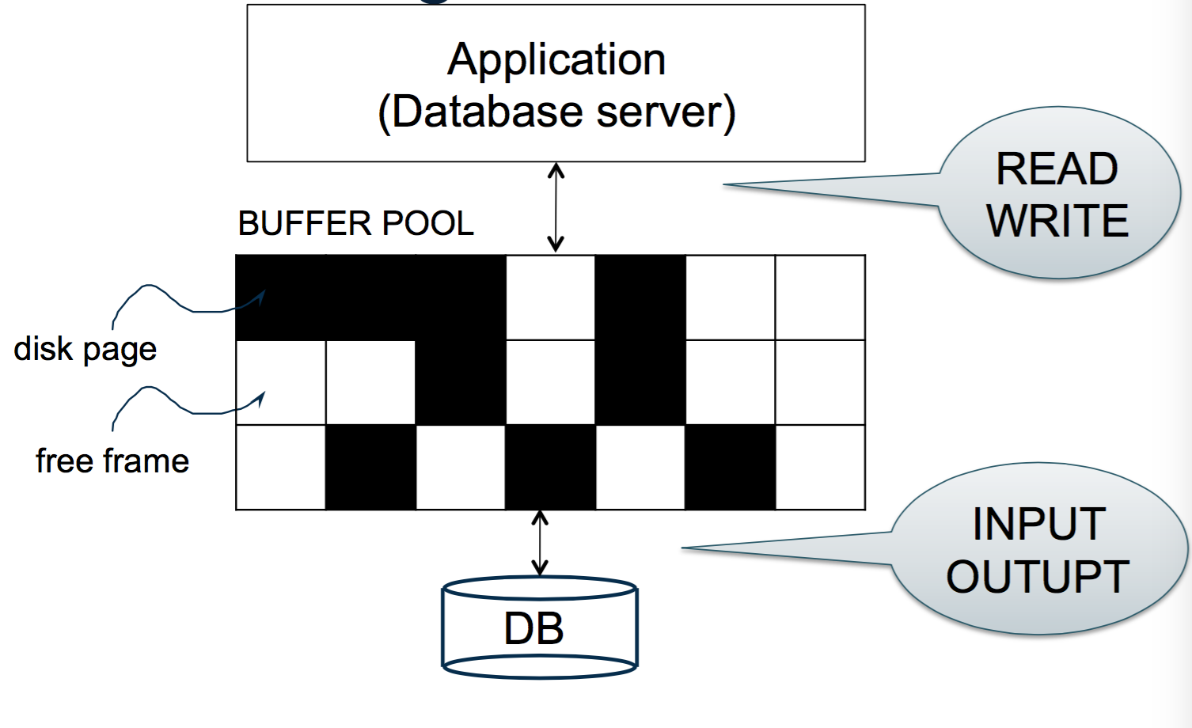
Buffer Management in a DBMS

Slide 7
Read
Compute the data block that contains the item to be read
Either
find a buffer containing the block, or
read from disk into a buffer
Copy the value from the buffer.

Slide 8
Write
Compute the disk block containing the item to be written,
Either
find a buffer containing the block, or
read from disk into a buffer,
Copy the new value into the buffer,
At some point (maybe later), write the buffer back to disk.

Slide 9
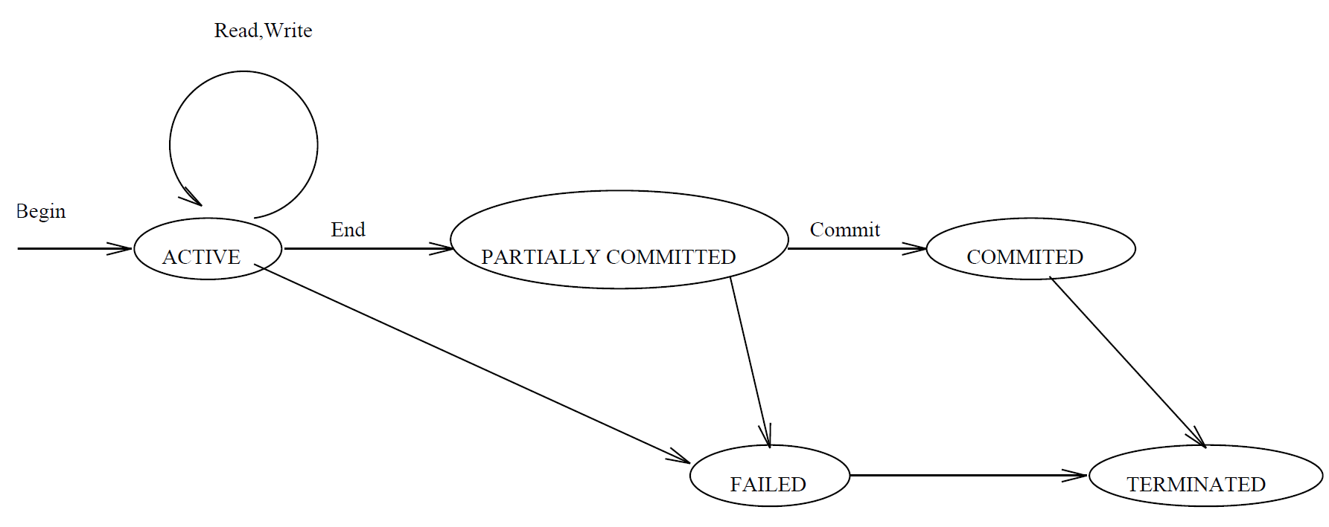
Processing States of a Transaction
The typical processing states are illustrated in the figure below (E/N Fig 17.4):
Partially committed point: At this point, check and enforce the correctness of the concurrent execution.
Committed state: Once a transaction enters the committed state, it has concluded its execution successfully.

Slide 10
Desirable Properties of Transaction Processing ACID
Atomicity: A transaction is either performed in its entirety or not performed at all.
Consistency preservation: A correct execution of the transaction must take the database from one consistent state to another.
Isolation: A transaction should not make its updates visible to other transactions until it is committed.
Durability or permanency: Once a transaction changes the database and the changes are committed, these changes must never be lost because of subsequent failure.

Slide 11
Problems without Enforcing ACID
For a banking system,
If durability is not enforced, then a customer may lose a deposit.
If consistency preservation is not enforced, then the bank runs a high risk of bankrupt. E.g., run-over upper-limit.
Below are the problems if atomicity and isolation are not enforced in a concurrent execution of transactions.

Slide 12
Lost Update Problem (Isolation is not enforced)
Suppose we have these two transactions, T₁ and T₂:
T1:
read(X)
T2:
read(X)
X ← X + N
write(X) read(Y)
X ← X + M
write(X)
Y ← Y − N
write(Y)
Let us see what may happen if T₁ and T₂ are executed concurrently
in an uncontrolled way:

Slide 13
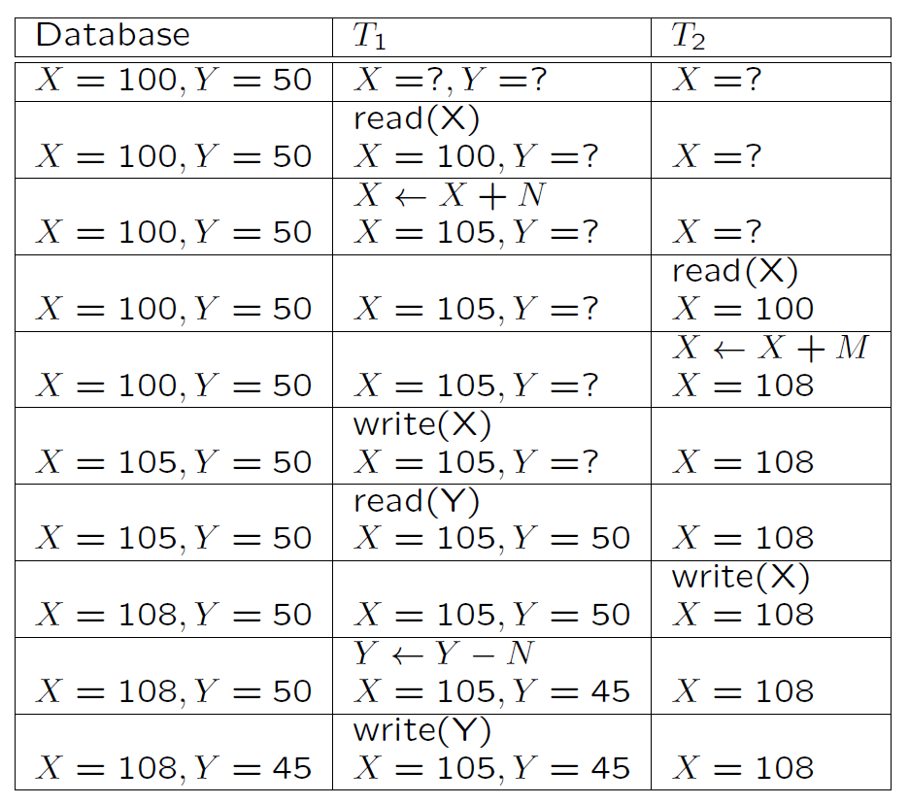
Suppose initially that X = 100; Y = 50;N = 5 and M = 8.

Slide 14
At the end of T₁ and T₂, X should be 113, Y should be 45.
The update X ← X + N has been lost.

Slide 15
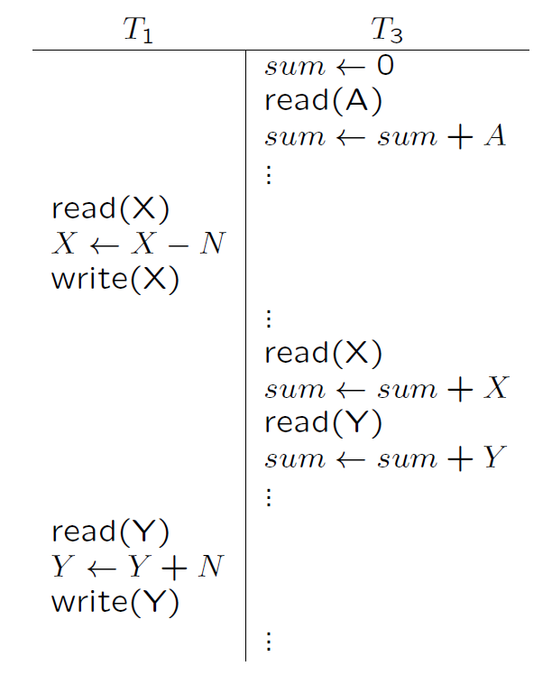
Incorrect Summary Problem (Isolation Issue)
Here the sum calculated by T₃ will be wrong by N.

Slide 16
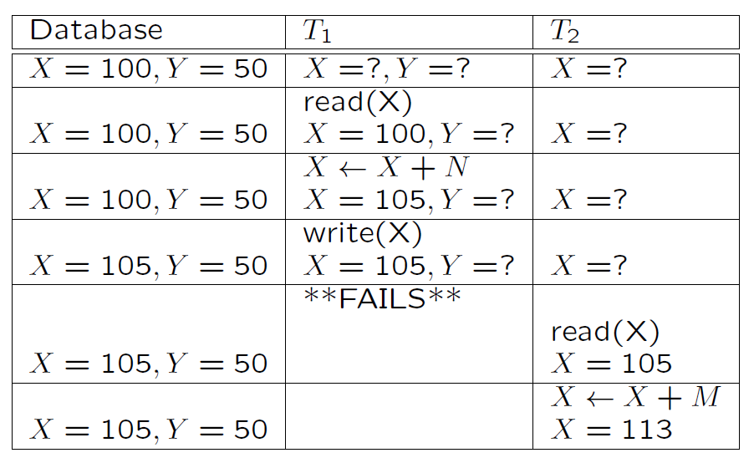
The Temporary Update Problem
Several possibilities for what might happen next:
Recover from the disk

Slide 17
Database | T₁ | T₂
X = 105, Y = 50 |  | X = 113
 |  | X = 113
X=100, Y=50
Case 1: DBMS undoes T₁
Write (X)
X= 113
X=113, Y=50
Database | T₁ | T₂
X = 105, Y = 50 |  | X = 113
 |  | X = 113
Case 1&2, only half of T₁ has been executed.
Case 3, T1 & T₂ have been lost.
X=105, Y=50
Case 2: DBMS does nothing to T₁
Write (X)
X= 113
X=113, Y=50
Database | T₁ | T₂
X = 105, Y = 50 |  | X = 113
X= 105, Y = 50 |  | X = 113
Write (X), X= 113
X=100, Y=50
Case 3: DBMS undoes T₁
X= 100

Slide 18
Recover from Failures
Ensure ACID
Log-based Recovery
Undo logging
Redo logging
Undo/Redo logging

Slide 19
System Log
System Log
The system needs to record the states information to recover failures correctly.
The information is maintained in a log (also called journal or audit trail).
The system log is kept in hard disk but maintains its current contents in main memory.

Slide 20
System Log
Start transaction marker [start transaction, T]: Records that transaction T has started execution.
[read item, T, X]: Records that transaction T has read the value of database item X.
[write item, T, X, old value, new value]: Records that T has changed the value of database item X from old value to new value.
Commit transaction marker [commit, T]: Records that transaction T has completed successfully, and arms that its effect can be committed (recorded permanently) to the database.
[abort, T]: Records that transaction T has been aborted.

Slide 21
System Log (Cont’d)
In fact some other entries (rollback, undo, redo) are also required for a recovery method.
These entries allow the recovery manager to rollback an unsuccessful transaction (undo any partial updates).

Slide 22
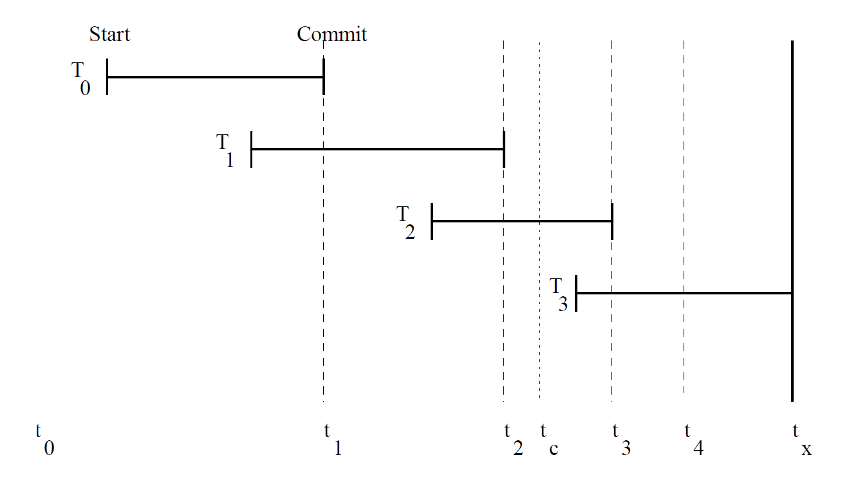
Recovery
Let us see how the log might be used to recover from a system crash.
The diagram below shows transactions between the last system backup and a crash.

Slide 23
Recovery (Cont’d)
The database on disk will be in a state somewhere between that at t₀ and the state at t_{x}.
The same is also true for log entries.

Slide 24
Recovery (Cont’d)
We will assume that the write-ahead log strategy is used. This means that
old data values must be force-written to the log (i.e. the buffer must be copied to disk) before any change can be made to the database, and
the transaction is regarded as committed when the new data values and the commit marker have been force-written to the log.
Thus the log is force-written at least at t₁, t₂ and t₃ in the above.

Slide 25
Suppose the log was last written to disk at t₄.
By examining the log:
We know that T₀, T₁ and T₂ have committed and their effects should be reflected in the database after recovery.
But we do not know whether the effects of T₀, T₁ and T₂ were reflected at the time of the crash.
We also know that T₃ has started, may have modified some data, but is not committed. Thus T₃ should be undone.

Slide 26
The database can be recovered by rolling back T₃ using the old data values from the log, and redoing the changes made by T₀ … T₂ using the new data values (for these committed transactions) from the log.
Notice that instead of rolling back, the database could have been restored from the backup. This might be necessary in the event of a disk crash for example (for this reason, the log should be stored on an independent disk pack).

Slide 27
Checkpoints
Notice also that using this system, the longer the time between crashes, the longer recovery may take.
To avoid this problem, the system may take checkpoints at regular intervals.
To do this:
a start of checkpoint marker is written to the log, then
the database updates in buffers are force-written, then
an end of checkpoint marker is written to the log.

Slide 28
In our example, suppose a checkpoint is taken at time t_{c}. Then on recovery we only need redo T₂.

Slide 29
Schedules of Transactions
To fully utilise resources, desirable to interleave the operations of transactions in an appropriate way.
For example, if one transaction is waiting for I/O to complete, another transaction can use the CPU.
A schedule S of the transactions T₁,…, T_{n}
is a sequential ordering of the operations of T₁,…, T_{n}, and
preserves the ordering of operations in each transaction T_{i}.

Slide 30
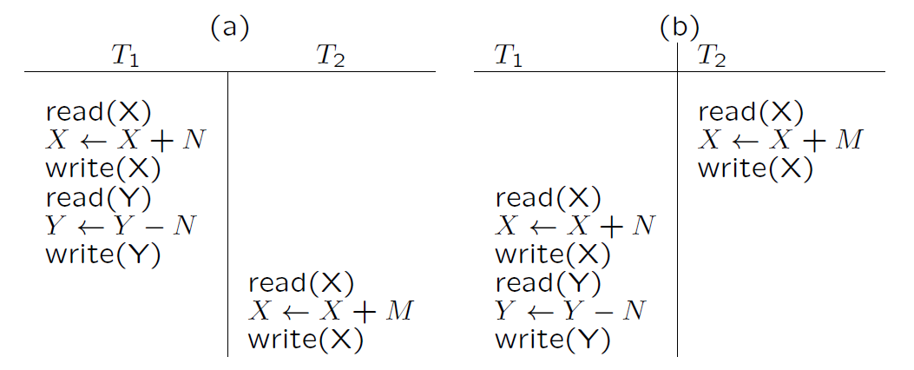
cannot swap read (X) and write (X)

Slide 31
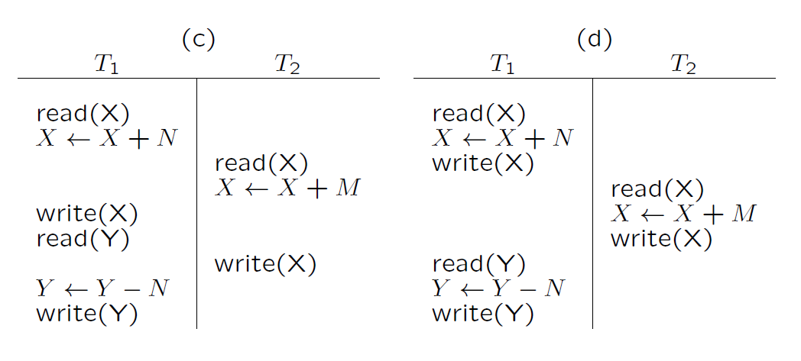
Incorrect
correct

Slide 32
As we have seen, if operations are interleaved arbitrarily, incorrect results may occur.
However, it is reasonable to assume that schedules (a) and (b) in the figure will give correct results (as long as the transactions are independent).
(a) and (b) are called serial schedules, and we will assume that any serial schedule is correct.
Notice that schedule (d) always produces the same result as schedules (a) and (b), so it should also give correct results.
A schedule is serializable if it always produces the same result as some serial schedule. (see E/N 17.5.1 for a formal definition).
Notice that schedule (c) is not serializable.

Slide 33
Scheduling Transactions
Schedule and Complete Schedule?
Serial schedule: Schedule that does not interleave the actions of different transactions.
Equivalent schedules: For any database state, the effect (on the set of objects in the database) of executing the first schedule is identical to the effect of executing the second schedule.
Serializable schedule: A schedule over a set S of transactions is equivalent to some serial execution of the set of committed transactions in S.
(Note: If each transaction preserves consistency, every serializable schedule preserves consistency. )

Slide 34
Serial Schedule

Slide 35
Non-serializable
Serializable

Slide 36
Scheduling Transactions (Cont.)
Recoverable schedule (RS): Transactions commit only after (and if) all transactions whose changes they read commit.
EX1: T1.R(X), T1.W(X), T2. R(X), T2.W(X), COMMIT.T2.
EX1 is not recoverable.
EX2: T1.R(X), T1.W(X), T2. R(X), T2.W(X), COMMIT.T1. Recoverable!
Avoid cascading aborts (ACA): Transactions read only the changes of committed transactions.
EX3: T1.R(X), T1.W(X), T2. R(X), T2.W(X)… EX3 is not ACA.
EX4: T1.R(X), T1.W(X), COMMIT.T1,T2. R(X), T2.W(X)… ACA!
Strict schedules (SS): A value written by a transaction is not read or overwritten by other transactions until T either aborts or commits.
EX5: T1.R(X), T1.W(X), T2.W(X)… EX5 is RS and ACA but not SS.
EX6: T1.R(X), T1.W(X), COMMIT.T1,T2.W(X)… EX6 is SS.
Note: SS is ACA and ACA is RS but not vice versa.

Slide 37
Check Serializability
When there are only two transactions, there are only two serial schedules - for n transactions there will be n!.
Fortunately there is an efficient algorithm to check whether a schedule is serializable without checking all these possibilities.

Slide 38
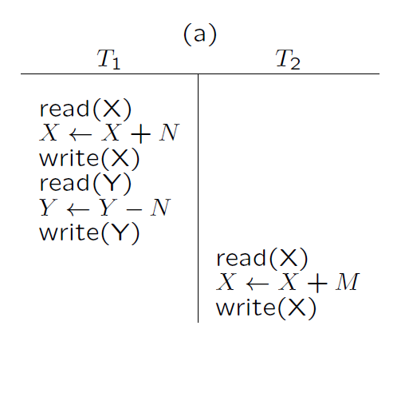
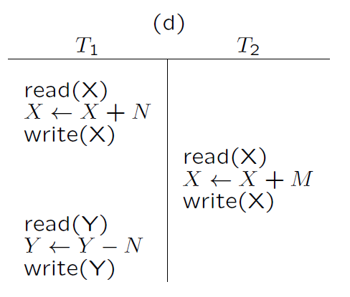
Conflict Serializable Schedules
Two schedules are conflict equivalent if:
Involve the same actions of the same transactions
Every pair of conflicting actions is ordered the same way
Schedule S is conflict serializable if S is conflict equivalent to some serial schedule

Slide 39
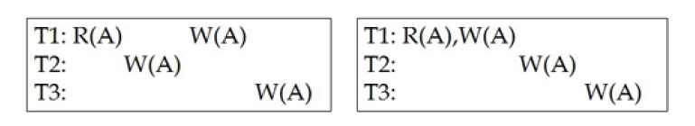
View Serializability
Schedules S1 and S2 are view equivalent if:
If Ti reads initial value of A in S1, then Ti also reads initial value of A in S2
If Ti reads value of A written by Tj in S1, then Ti also reads value of A written by Tj in S2
If Ti writes final value of A in S1, then Ti also writes final value of A in S2
A schedule is view serializable if view equivalent to a serial schedule.

Slide 40
Properties of Serizability
View Serializability does not have monotonic property; that is, a schedule is view serializable but its sub-schedule may not necessarily view serializable.
Example:
Yes!
No!
T1: R (A) W(A)
T2: W (A)
T3: W(A)
T1: R (A) W(A)
T2: W (A)
If no blind writes, conflict serializability is equivalent
to view serializability .

Slide 41
Check Conflict Serializability
Algorithm
Step 1: Construct a schedule (or precedence) graph – a directed graph.
Step 2: Check if the graph is cyclic:
Cyclic: non-serializable.
Acyclic: serializable.

Slide 42
A directed graph G = (V, A) consists of
a vertex set V, and
an arc set A such that each arc connects two vertices.
G is cyclic if G contains a directed cycle.
Cyclic Graph

Slide 43
Construct a Schedule Graph G_{S} = (V, A) for a schedule S
A vertex in V represents a transaction.
For two vertices T_{i} and T_{j}, an arc T_{i} →T_{j} is added to A if
there are two conflicting operations O₁ ∈ T_{i} and O₂ ∈ T_{j},
in S, O₁ is before O₂.
Two operations O₁ and O₂ are conflicting if
they are in different transactions but on the same data item,
one of them must be a write.

Slide 44
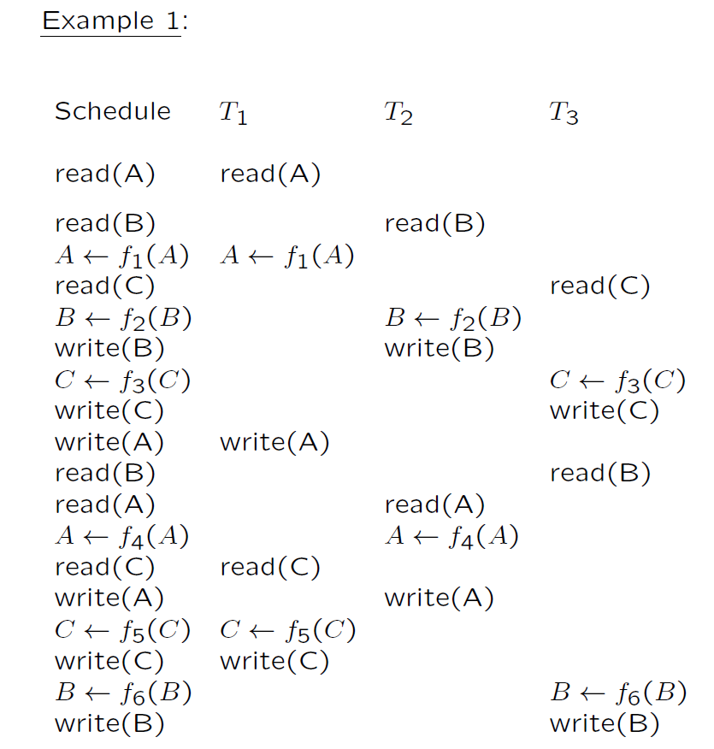

Slide 45
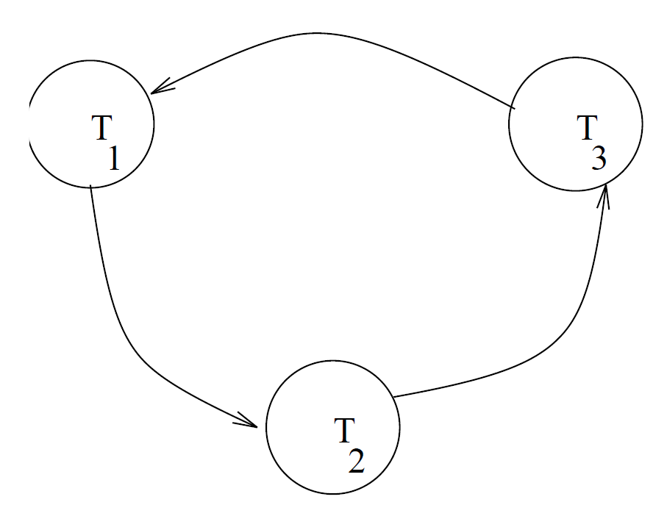

Slide 46
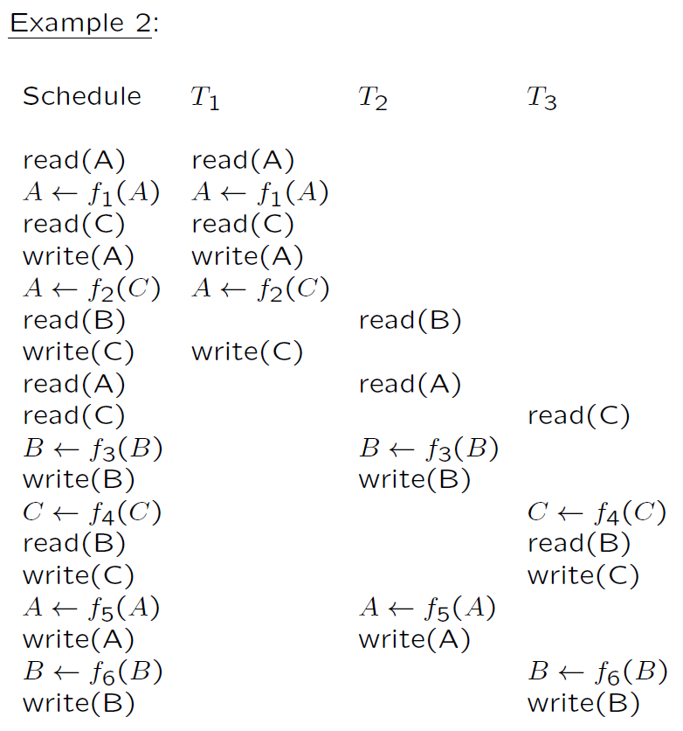

Slide 47
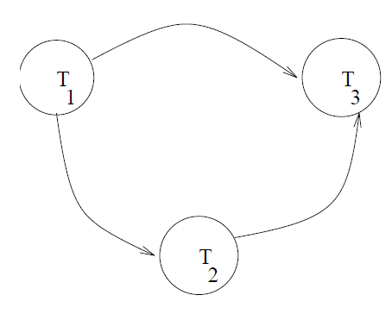
Unfortunately, testing for serializability on the fly is not practical.
Instead, a number of protocols have been developed which ensure that if every transaction obeys the rules, then every schedule will be serializable, and thus correct.

Slide 48
SS is serializable?
irrelevant!
Example:
T1.R(X), T2.R (X), T1.W(X), COMMIT.T1, T2.W(X), COMMIT.T2

